Slide 1
Final Project
- V0 & Optimization

Slide 2
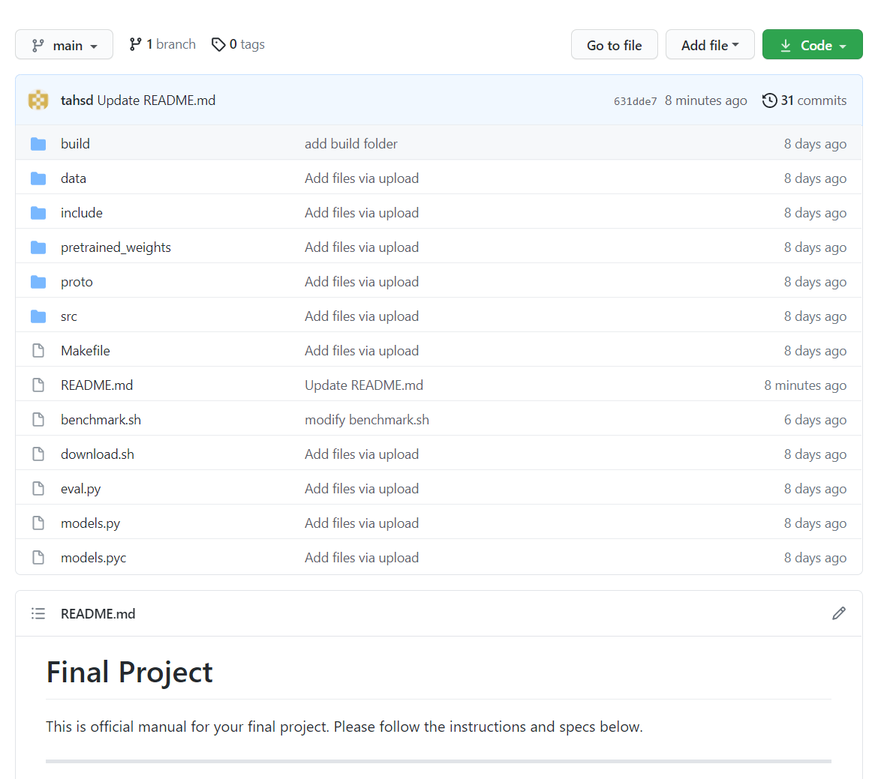
Github Repository
https://github.com/tahsd/hsd21_project

Slide 3
Final Term Project Notification
Term Project V0 & Optimization
Term Project V0
Implement 8x8 Matrix-Matrix multiplication accelerator
Term Project Optimized Version (Optional)
Optimize your work
Optimization methods
We suggest three ways to optimize your work : DMA / Quantization / Zero Skipping
DMA
It boots data transfer speed between DRAM and BRAM.
Quantization
Quantize both your activation and weights to 8-bit integer.
Zero-Skipping
Avoid multiplication with zeroes to save computation time

Slide 4
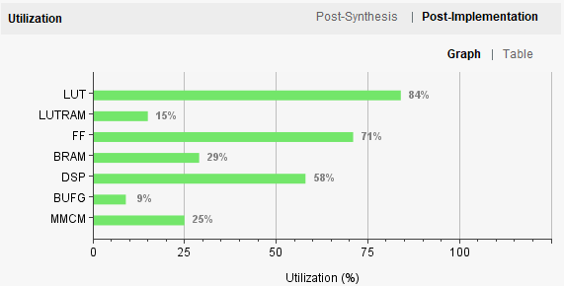
Optimization (1) Quantization
Modify your SW/HW codes for INT8 quantization.
Upgrade your IP
Switch 32b DSP with 8b integer multiply-adder
Recall lab3: multadd IP
Dataset and CNN model will be given in INT8 format
Report the results
Performance gain
Compare computation time between fp32 and INT8 ver.
Utilization
After implementation

Slide 5
Optimization (2) Zero-skip
Modify your SW/HW codes for zero-skipping.
Reduce zero data operations
Zero data transmission is redundant
Zero data calculation is redundant
Report the results
Performance gain
Compare computation time between and after each project
Utilization
If you modify hardware

Slide 6
Optimization (3) DMA
Try to build your system with DMA
Modify the SW codes and HW block design
Report the results
Performance gain
Compare computation time between and after each project

Slide 7
Rules for optimization
You can try more than one optimization,
but do not apply multiple optimizations at the same time.
If you have done quantization & DMA, for example, submit three verions of your work.
V0 (Baseline)
V0 + quantization
V0 + DMA
You should include the same V0 for all the versions.
Each version of your work will be evaluated independently.

Slide 8
Schedule
Important schedule
5/31 : Final exam
6/2 : Interim submission
6/19 : Final submission

Slide 9
Scoring Criteria
Implementation
Baseline
Once you succeed any implementation of those optimizing methods, you will get additional score regardless its performance.
Inference time
Baseline
You will be scored on the speed gain by using each optimizing method.
Accuracy
Baseline
Accuracy should be robust enough to quantization and zero-skipping.
Report

Slide 10
Report
Explain SW/HW System that you implemented.
It is sufficient to include only project-specific contents.
You must include the results and analysis of your work
inference time, total_image, accuracy, etc.
If you implement any optimized version, compare the results between V0 and the optimized one and include your analysis in the report.
Your submission should reproduce the same result as in the report.
Either in Korean or in English
# of pages does not matter
PDF only!!

Slide 11
Final Term Project Notification
Requirements
Result
Attach all the HW/SW project folders and the bitstream file for the V0 version.
If you have implemented optimized ones, attach them additionally. (Refer to Slide 7)
Attach a video that can show the results
Below is a description of the scenario in which you take a video
1. Keep the camera away and make sure your host computer and ZedBoard are all visible
2. Turn on your ZedBoard
3. Zoom that camera into the host monitor & start minicom
4. Run benchmark.sh
Bitstream file’s name: "<Team_number>_zynq_<Version>.bit" ex) 7_zynq_V0.bit / 7_zynq_dma.bit
Software code folder name: "<Team_number>_SW_<Version>" ex) 7_SW_V0 / 7_SW_dma,
- Report
Result + Report to one .zip file
Upload (.zip) file on ETL
Submit one (.zip) file
[Project]name1_name2.zip
Due: 6/19(SAT) 23:59
No Late Submission

